Slide 1
Ch.10 Array

Slide 2
What you will learn in this chapter
Arrays allow you to allocate space to store multiple values at once .
Understanding the concept of repetition
The concept of arrays
Declaration and initialization of arrays
One-dimensional array
Multidimensional array

Slide 3
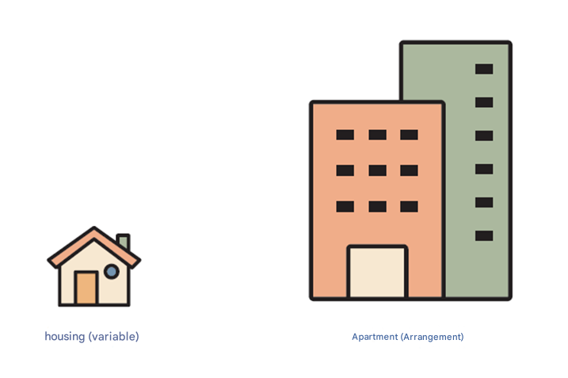
Array
Arrays allow you to create multiple variables at once .
int s[10];

Slide 4
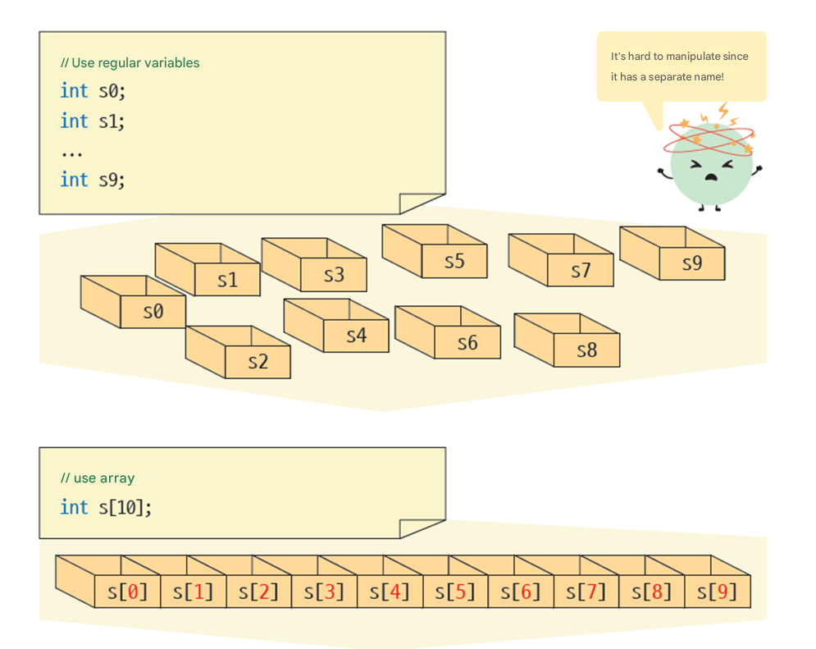
The need for arrays

Slide 5
Array of characteristic
Arrays are stored in a contiguous space in memory . For example, the array elements s[0] and s[1] above are physically adjacent to each other in memory.
The biggest advantage of an array is that you can access and process related data sequentially . If the related data have different names, you would have to remember each name.
However, if they share one name and only have different numbers, they are very easy to remember and convenient to use.

Slide 6
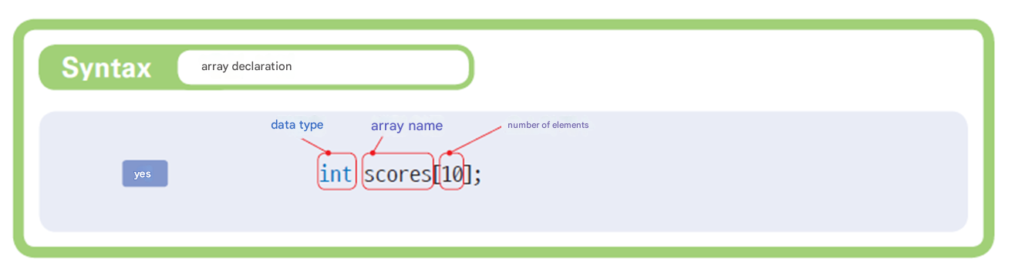
Array declaration

Slide 7
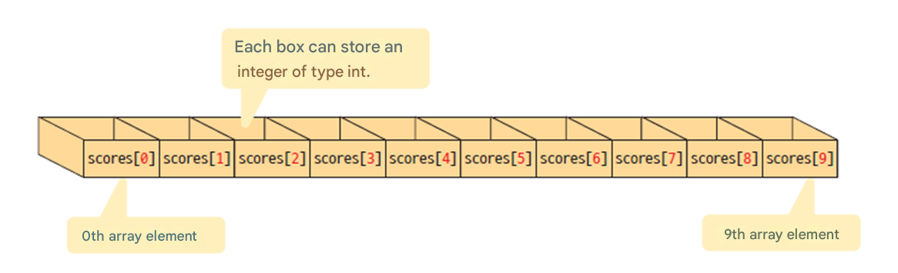
Array elements and indices
Index : Number of array elements

Slide 8
Example of array declaration
// Array score with 60 int type values
int score[60];
float cost[12];
/ / Array cost with 12 float type values
char name[50];
// Array name with 50 char type values

Slide 9
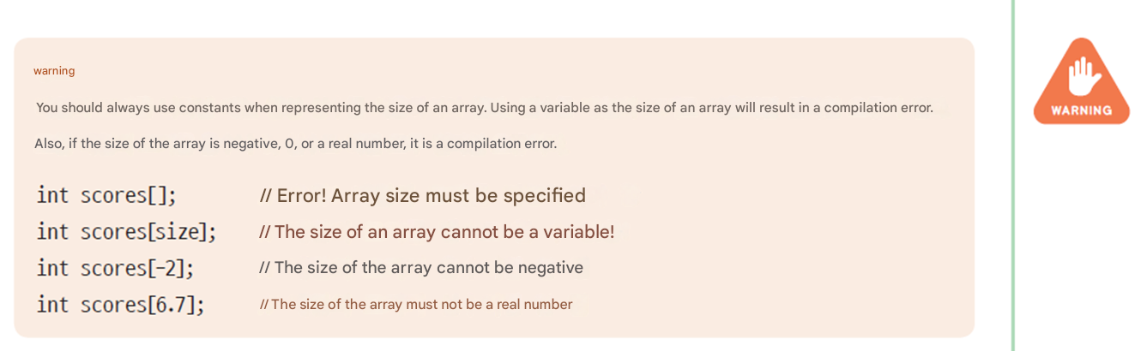
caution

Slide 10
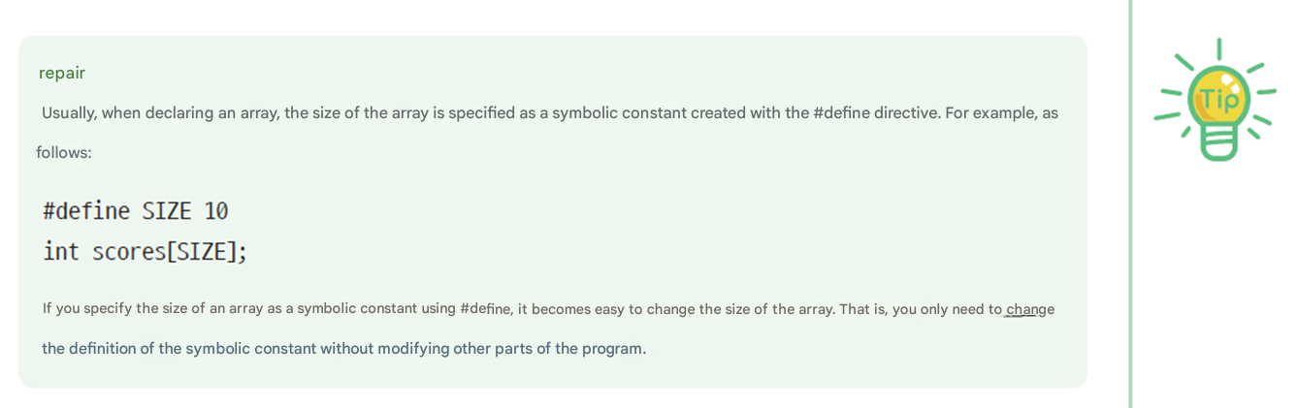
Using symbolic constants

Slide 11
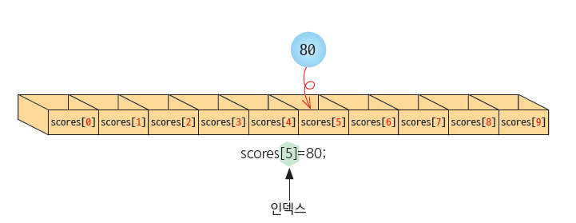
Accessing array elements
scores[5] = 80;
scores[1] = scores[0];
scores[ i ] = 100; // i is an integer variable
scores[i+2] = 100; // The formula becomes the index .
scores[index[3]] = 100; // index[] is an array of integers

Slide 12

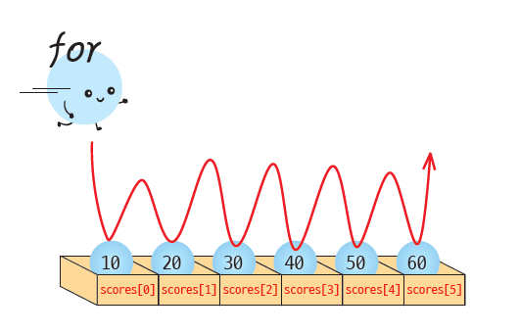
Array Basics Example
Let's start with a basic example of declaring an array and assigning values to array elements . The for loop is useful when processing array elements one by one .
scores[0]=10
scores[1]=20
scores[2]=30
scores[3]=40
scores[4]=50

Slide 13
Array Basics Example
#include < stdio.h >
int main( void )
{
int i ;
int scores[5];
scores[0] = 10;
scores[1] = 20;
scores[2] = 30;
scores[3] = 40;
scores[4] = 50;
for ( i =0; i < 5; i ++)
printf ( "scores[%d]=%d\n" , i , scores[ i ]);
return 0;
}
scores[0]=10
scores[1]=20
scores[2]=30
scores[3]=40
scores[4]=50

Slide 14
Array and Loop
The biggest advantage of arrays is that you can easily process the elements of the array using a loop.
scores[0] = 0;
scores[1] = 0;
scores[2] = 0;
scores[3] = 0;
scores[4] = 0;
#define SIZE 5
...
for ( i =0 ; i <SIZE ; i ++)
scores[ i ] = 0;

Slide 15
Fill array with random numbers
This is an example of defining an array and using a repeating structure to initialize and print the values of the array elements with random numbers .
scores[0]=41
scores[1]=67
scores[2]=34
scores[3]=0
scores[4]=69

Slide 16
Fill array with random numbers
#include < stdio.h >
#include < stdlib.h >
#include < time.h >
#define SIZE 5
int main( void )
{
int i ;
int scores[SIZE];
srand ((unsigned)time(NULL));
for (i = 0; i < SIZE; i++)
scores[ i ] = rand() % 100;
for (i = 0; i < SIZE; i++)
printf( "scores[%d]=%d\n" , i, scores[i]);
return 0;
}
scores[0]=41
scores[1]=67
scores[2]=34
scores[3]=0
scores[4]=69

Slide 17
Example #3: Calculating the grade average
five students using arrays . Imagine how difficult it would have been if we had used five variables instead of an array .
Enter students' grades : 10
Enter students' grades : 20
Enter students' grades : 30
Enter students' grades : 40
Enter students' grades : 50
Grade average = 30

Slide 18
Example #3: Calculating the grade average
#include < stdio.h >
#define STUDENTS 10
int main( void )
{
int scores[ STUDENTS ];
int sum = 0;
int i , average;
for (i = 0; i < STUDENTS ; i++)
{
printf ( " Enter students' grades : " );
scanf ( "%d" , &scores[ i ]);
}
for (i = 0; i < STUDENTS ; i++)
sum += scores[ i ];
average = sum / STUDENTS ;
printf ( " Grade average = %d\n" , average);
return 0;
}
Enter students' grades : 10
Enter students' grades : 20
Enter students' grades : 30
Enter students' grades : 40
Enter students' grades : 50
Grade average = 30

Slide 19
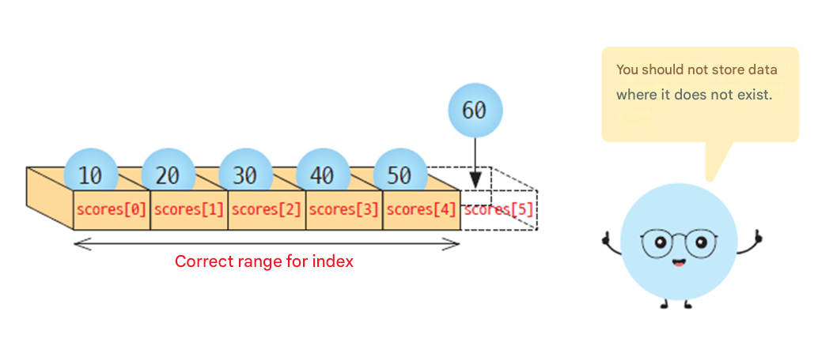
Bad index problem
If the index exceeds the size of the array, the program will cause a fatal error .
C , it is the programmer's responsibility to ensure that the index is not out of range .
int scores[5];
…
scores[5] = 60; // Fatal error !

Slide 20
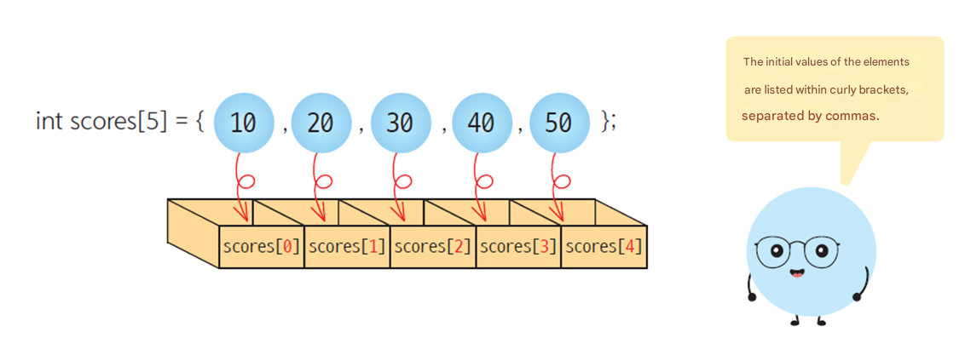
Initializing an array
To initialize an array, separate the initial values with commas, enclose them in curly brackets { } , and assign them when declaring the array .

Slide 21
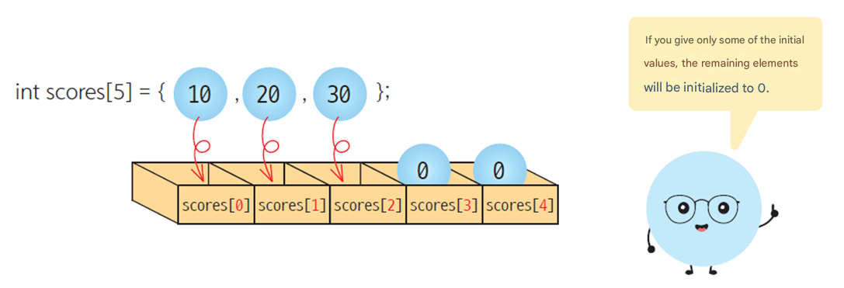
Initializing an array
If the number of initial values is less than the number of elements, only the elements in front are initialized . All remaining array elements are initialized to 0.

Slide 22
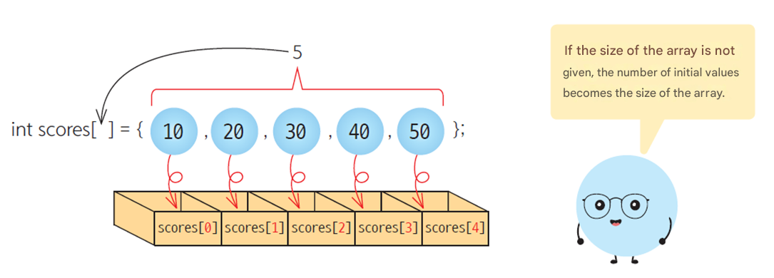
Initializing an array
If you leave the array size empty, the compiler will automatically set the array size to the number of initial values .

Slide 23
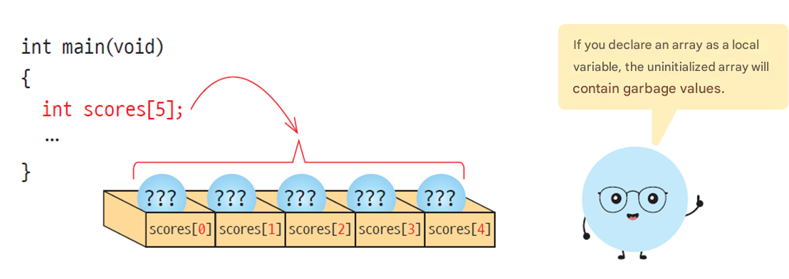
What if no initial value was given ?
If the array is declared as a local variable and no initial value is given , it has no meaning, just like a normal local variable. The price of garbage is included .

Slide 24
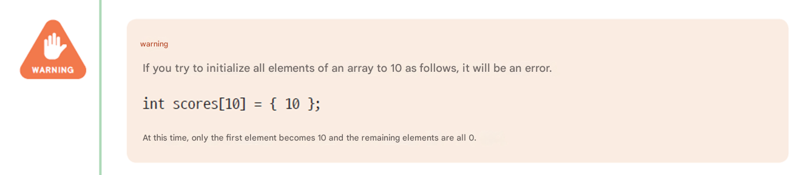
warning

Slide 25
Array initialization example
#include < stdio.h >
#define SIZE 5
int main( void )
{
int i ;
int scores[SIZE] = { 31, 63, 62, 87, 14 };
for (i = 0; i < SIZE; i++)
printf( "scores[%d] = %d\n" , i, scores[i]);
return 0;
}
scores[0] = 31
scores[1] = 63
scores[2] = 62
scores[3] = 87
scores[4] = 14

Slide 26
Array initialization example
#include < stdio.h >
#define SIZE 5
int main( void )
{
int i ;
int scores[SIZE] = { 31, 63 };
for (i = 0; i < SIZE; i++)
printf( "scores[%d] = %d\n" , i, scores[i]);
return 0;
}
scores[0] = 31
scores[1] = 63
scores[2] = 0
scores[3] = 0
scores[4] = 0

Slide 27
Array initialization example
#include < stdio.h >
#define SIZE 5
int main( void )
{
int i ;
int scores[SIZE] ;
for (i = 0; i < SIZE; i++)
printf( "scores[%d] = %d\n" , i, scores[i]);
return 0;
}
scores[0]=4206620
scores[1]=0
scores[2]=4206636
scores[3]=2018779649
scores[4]=1

Slide 28
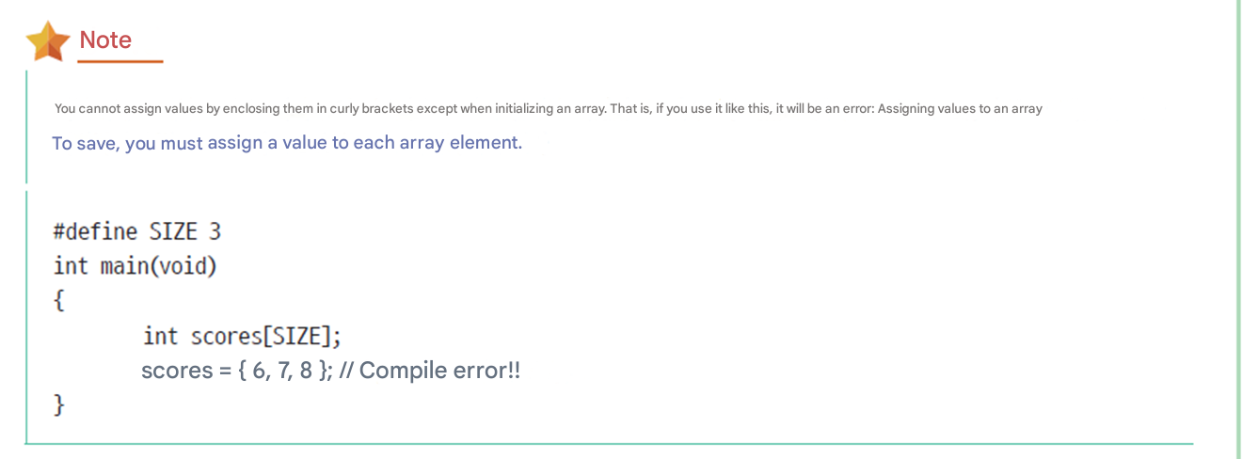
reference

Slide 29
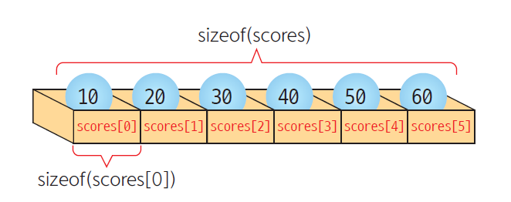
Counting the number of array elements
int scores[] = { 1, 2, 3, 4, 5, 6 };
int i , size;
size = sizeof (scores) / sizeof (scores[0]);
for ( i = 0; i < size ; i ++)
printf ( "%d " , scores[ i ]);
Automatically calculate the number
of array elements

Slide 30
Copying an array
int a[SIZE] ={1, 2, 3, 4, 5};
int b[SIZE];
a = b; // compile error !
Wrong way
int a[SIZE] ={1, 2, 3, 4, 5};
int b[SIZE];
int i ;
for ( i = 0; i < SIZE; i ++)
a[ i ] = b[ i ];
Copy each element one by one
The right way

Slide 31
Comparing arrays
#include < stdio.h >
#define SIZE 5
int main( void )
{
int i ;
int a[SIZE] = { 1, 2, 3, 4, 5 };
int b[SIZE] = { 1, 2, 3, 4, 5 };
if ( a == b ) // ① Incorrect array comparison
printf ( " Incorrect result .\n" );
else
printf ( " Incorrect result .\n" );

Slide 32
Comparing arrays
Compare elements one by one
for ( i = 0; i < SIZE ; i ++) // ② Correct array comparison
{
if ( a[ i ] != b[ i ] )
{
printf ( "a[] and b[] are not equal .\n" );
return 0;
}
}
printf ( "a[] and b[] are equal .\n" );
return 0;
}

Slide 33

Lab: Finding the minimum
When we buy products on the Internet , we search for the cheapest price through price comparison sites .
similar to the problem of finding the minimum value among the integers in an array .

Slide 34
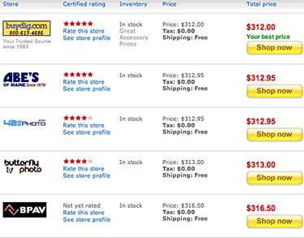
Execution results
---------------------------------------
1 2 3 4 5 6 7 8 9 10
---------------------------------------
28 81 60 83 67 10 66 97 37 94
The minimum value is 10 .

Slide 35
Algorithm
Initialize the elements of array prices[] to random numbers .
assume that the first element is the minimum value minium .
for( i =1; i < size of array ; i ++)
if ( prices[ i ] < minimum )
minimum = prices[ i ]
When the iteration ends, the minimum value is stored in minimum .

Slide 36
Lab: Finding the minimum
#include < stdio.h >
#include < stdlib.h >
#include < time.h >
#define SIZE 10
int main( void )
{
int prices[SIZE] = { 0 };
int i , minimum;
printf ( "---------------------------------------\n" );
printf ( "1 2 3 4 5 6 7 8 9 10\n" );
printf ( "---------------------------------------\n" );
srand ( ( unsigned )time( NULL ) );
for ( i = 0; i < SIZE; i ++){
prices[ i ] = (rand()%100)+1;
printf ( "%-3d " ,prices[ i ]);
}
printf ( "\n\n" );
Output the price of the item

Slide 37
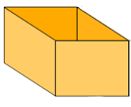
Lab: Finding the minimum
minimum = prices[0];
for ( i = 1; i < SIZE; i ++)
{
if ( prices[ i ] < minimum )
minimum = prices[ i ];
}
printf ( " The minimum value is %d .\n" , minimum);
return 0;
}
Assume the first array element is the minimum
If an array element is smaller than the current minimum , the array element is copied to the minimum .
50
40
30
20
10
50
40
30
20
10
20
30
40
60
70
score [0] score [1] score [2] score [3] score [4] score [5] score [6] score [7] score [8] score [9]
<
<
<
<
>
>
>
>
>
30
40
20
50
10
min

Slide 38
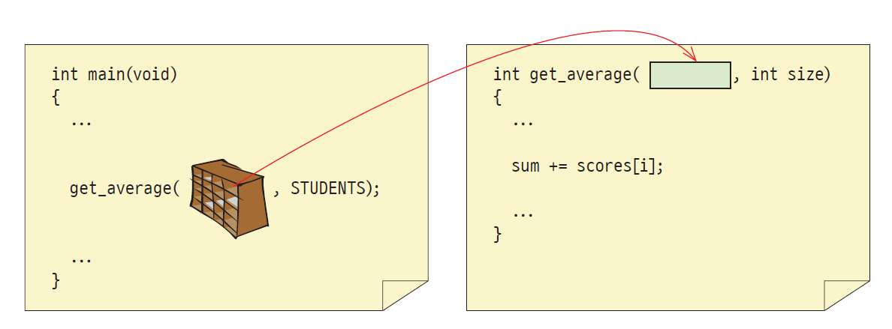
Arrays and functions
In the case of arrays, the original is passed, not a copy .

Slide 39
Arrays and functions
#include < stdio.h >
#define STUDENTS 5
int get_average ( int scores[], int n); // ①
int main( void )
{
int scores[STUDENTS] = { 1, 2, 3, 4, 5 };
int avg ;
avg = get_average (scores, STUDENTS);
printf ( " The average is %d .\n" , avg );
return 0;
}
int get_average ( int scores[], int n) // ②
{
int i ;
int sum = 0;
for ( i = 0; i < n; i ++)
sum += scores[ i ];
return sum / n;
}
If the argument is an array ,
The address of the array is passed .
The original of the array is passed to score[]
The average is 3 .

Slide 40
When array is an argument of a function
#include < stdio.h >
#define SIZE 7
void modify_array ( int a[], int size);
void print_array ( int a[], int size);
int main( void )
{
int list[SIZE] = { 1, 2, 3, 4, 5, 6, 7 } ;
print_array ( list , SIZE);
modify_array ( list , SIZE);
print_array ( list , SIZE);
return 0;
}
Arrays are passed by address .

Slide 41
When array is an argument of a function
void modify_array ( int a[], int size)
{
int i ;
for ( i = 0; i < size; i ++)
++a[ i ];
}
void print_array ( int a[], int size)
{
int i ;
for ( i = 0; i < size; i ++)
printf ( "%3d " , a[ i ]);
printf ( "\n" );
}
1 2 3 4 5 6 7
2 3 4 5 6 7 8

Slide 42

How to prevent changes to the original array
void print_array ( const int a[], int size)
{
...
a[0] = 100; // Compile error !
}
a[] cannot be changed inside the function
The const keyword means that it cannot be changed, right ?
const means that it cannot be changed .

Slide 43

What is sorting?
Sorting is arranging items in ascending or descending order of size.
Sorting is one of the most basic and important algorithms in computer engineering.

Slide 44

What is sorting ?
Sorting is essential for data exploration .
( Example ) What if the words are not sorted in the dictionary ?

Slide 45
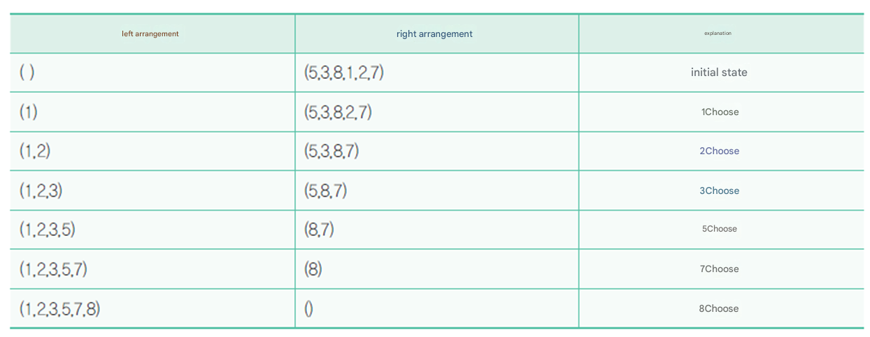
Selection sort
Selection sort : Select the minimum value from the unsorted numbers and exchange it with the first element of the array.

Slide 46
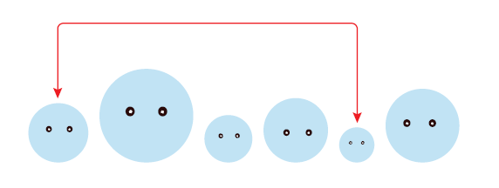
Array If you only want to use one ?
to handle the value in the first place, and we can do this by taking advantage of the fact that the place where the minimum value was is empty .

Slide 47
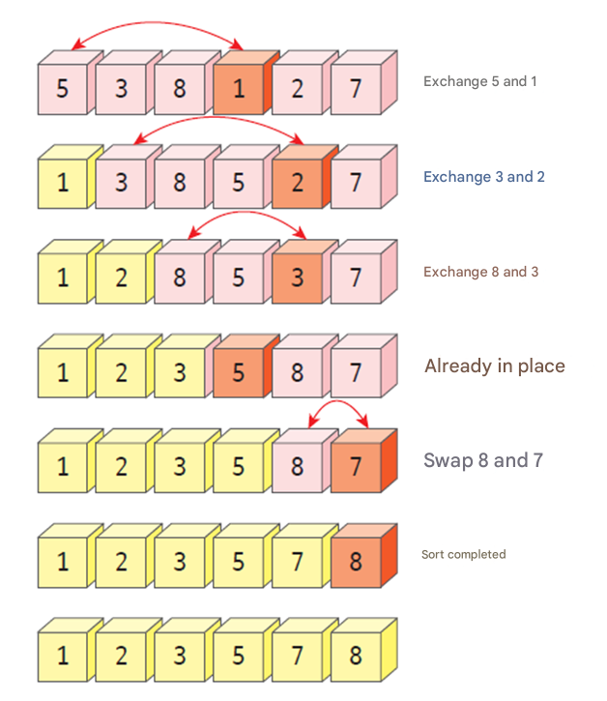
Selection sort
Selection sort : Select the minimum value from the unsorted numbers and exchange it with the first element of the array.

Slide 48
Selection Sort
#include < stdio.h >
#define SIZE 10
int main( void )
{
int list[SIZE] = { 3, 2, 9, 7, 1, 4, 8, 0, 6, 5 };
int i , j, temp, least;
for ( i = 0; i < SIZE-1; i ++)
{
least = i ;
for (j = i + 1; j < SIZE; j++)
if (list[j] < list[least])
least = j;
temp = list[ i ];
list[ i ] = list[least];
list[least] = temp;
}
an inner for loop, it finds the minimum value from the (i+1) th element to the last element of the array. If a smaller integer is found by comparing it to the current minimum value, the index containing that integer is stored in least.
Swap list[ i ] and list[least]

Slide 49
Selection Sort
for ( i = 0; i < SIZE; i ++)
printf ( "%d " , list[ i ]);
printf ( "\n" );
return 0;
}
0 1 2 3 4 5 6 7 8 9

Slide 50
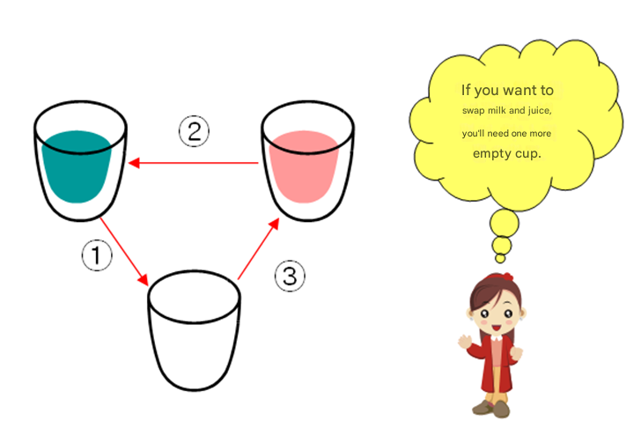
When exchanging the values of variables
Do not do the following:
list[ i ] = list[least]; // The existing value of list[ i ] is destroyed !
list[least] = list[ i ];
The right way
temp = list[ i ];
list[ i ] = list[least];
list[least] = temp;

Slide 51
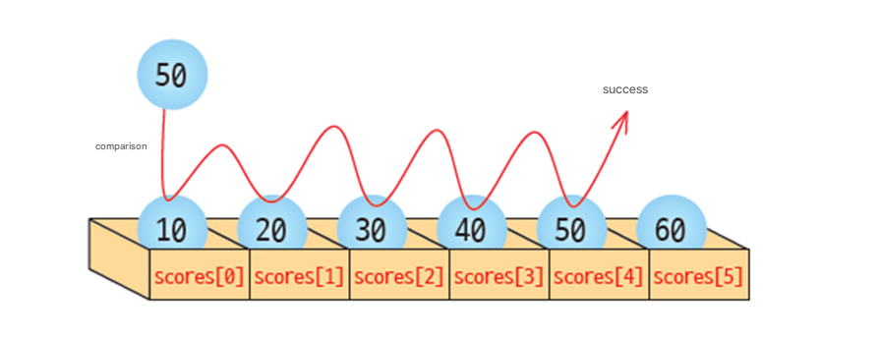
Sequential search
Sequential The search is Array of The elements In order singly Take it out With the navigation keys By comparison desirous The value Go to method

Slide 52
Sequential search
#include < stdio.h >
#define SIZE 10
int main( void )
{
int key, i ;
int list[SIZE] = { 1, 2, 3, 4, 5, 6, 7, 8, 9 };
printf ( " Enter the value to search for :");
scanf ( "%d" , &key);
for ( i = 0; i < SIZE; i ++)
if (list[ i ] == key)
printf ( " Search success index = %d\n", i );
printf ( " Search ended \n");
return 0;
}
Using a for loop , the operation of comparing list[i] and key is repeated as many times as the size of the array. If list[i] and key are the same, the search is successful and the index of the array where the key value was found is printed .
Enter the value to search for :7
Search Success Index = 6
End of navigation

Slide 53
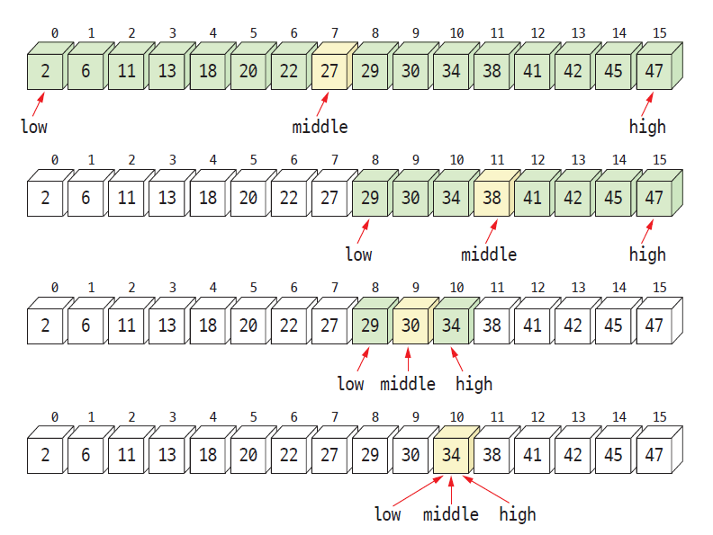
Binary search
Binary search : Repeated comparison with the element located at the center of a sorted array.

Slide 54
Binary search
#include < stdio.h >
#define SIZE 16
int binary_search ( int list[], int n, int key);
int main( void )
{
int key;
int grade [SIZE] = { 2,6,11,13,18,20,22,27,29,30,34,38,41,42,45,47 };
printf ( " Enter the value to search for :" );
scanf ( "%d" , &key);
printf ( " Search result = %d\n" , binary_search (grade, SIZE, key));
return 0;
}

Slide 55
Binary search
int binary_search ( int list[], int n, int key)
{
int low, high, middle;
low = 0;
high = n-1;
while ( low <= high ){ // If there are still numbers left
printf ( "[%d %d]\n" , low, high); // Print the lower and upper limits .
middle = (low + high)/2; // Calculate the middle position .
if ( key == list[middle] ) // If matched, search succeeds
return middle;
else if ( key > list[middle] ) // If it is greater than the middle element
low = middle + 1; // set
else
high = middle - 1; // set high to a new value
}
return -1;
}

Slide 56
Execution results
Enter the value to search for :34
[0 15]
[8 15]
[8 10]
[10 10]
Search Results = 10

Slide 57
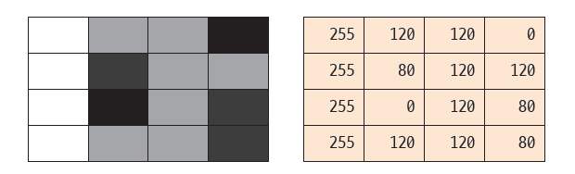
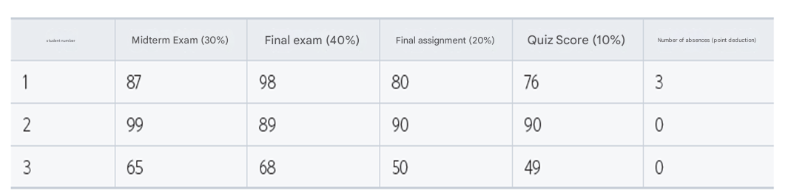
2-dimensional array
The data itself is often two-dimensional . For example, digital images or board games are fundamentally two-dimensional.

Slide 58
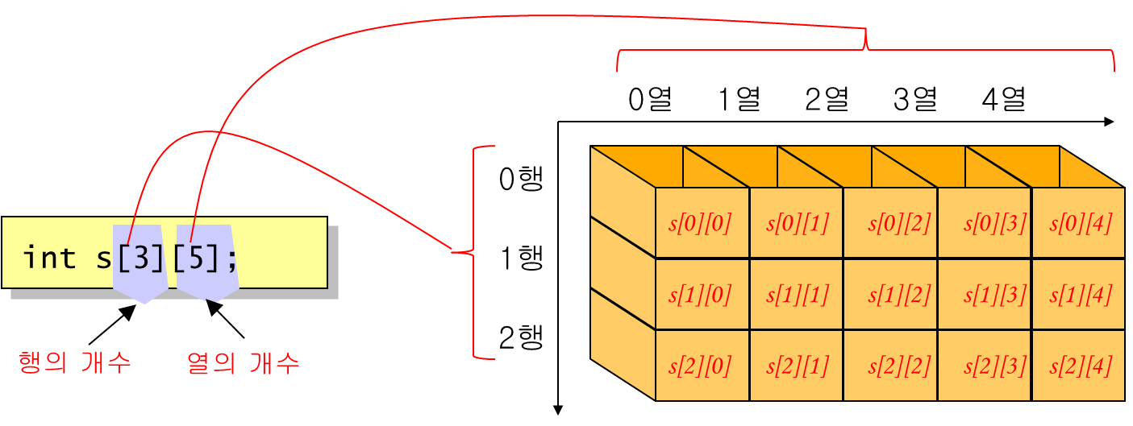
2-dimensional array
int s[10]; // one- dimensional array
int s[3][10]; // 2- dimensional array
int s[5][3][10]; // 3- dimensional array

Slide 59
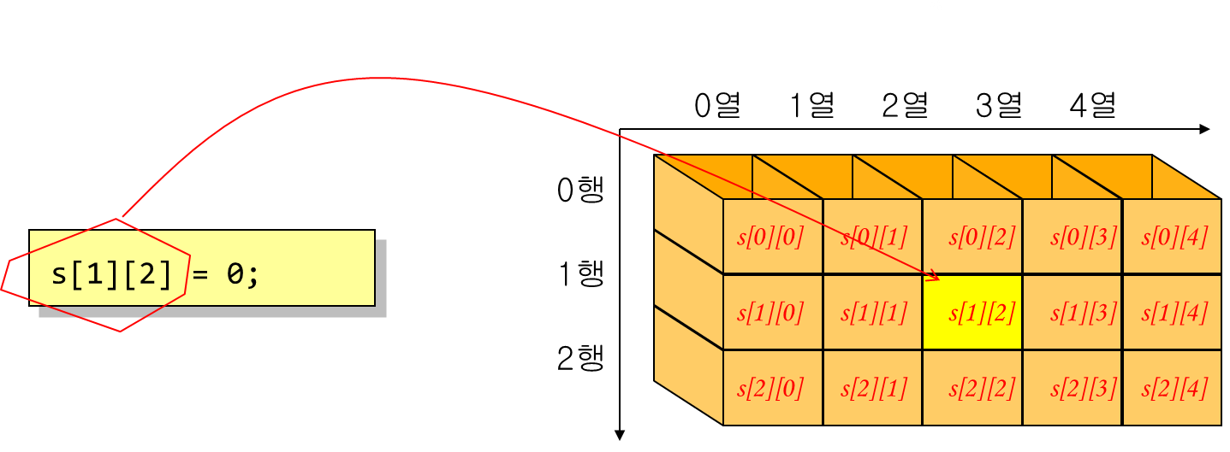
Index in a 2-dimensional array

Slide 60
Utilizing 2-dimensional arrays
#include < stdio.h >
#include < stdlib.h >
#include < time.h >
#define ROWS 3
#define COLS 5
int main( void )
{
int s[ ROWS ][ COLS ]; // Declare a two-dimensional array
int i , j; // 2 index variables
srand (( unsigned )time(NULL)); // Initialize
for (i = 0; i < ROWS ; i++)
for (j = 0; j < COLS ; j++ )
s[i][j] = rand() % 100;
for (i = 0; i < ROWS ; i++) {
for (j = 0; j < COLS ; j++ )
printf( " % 02d " , s[i][j]);
printf ( "\n" );
}
return 0;
}
61 10 53 60 54
90 45 73 00 90
80 82 93 45 67

Slide 61
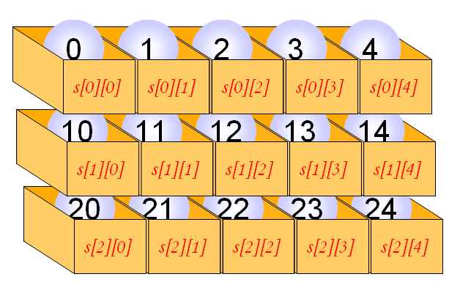
Initializing a 2-dimensional array
int s[3][5] = {
{ 0, 1, 2, 3, 4 }, // Initial values of elements in the first row
{ 10, 11, 12, 13, 14 }, // Initial values of elements in the second row
{ 20, 21, 22, 23, 24 } // Initial values of elements in the third row
};

Slide 62
Initializing a 2-dimensional array
int s[ ][5] = {
{ 0, 1, 2, 3, 4 }, // Initial values of elements in the first row
{ 10, 11, 12, 13, 14 }, // Initial values of elements in the second row
{ 20, 21, 22, 23, 24 }, // Initial values of elements in the third row
};

Slide 63
Initializing a 2-dimensional array
int s[ ][5] = {
0, 1, 2, 3, 4, 10, 11, 12, 13, 14, 20, 21, 22, 23, 24
};

Slide 64
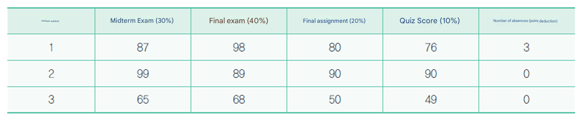
Example
the students' grade sheets in a two- dimensional array and calculate the final grade for each student .

Slide 65
Initializing a 2-dimensional array
#include < stdio.h >
#define ROWS 3
#define COLS 5
int main( void )
{
int a[ ROWS ][ COLS ] = { { 87, 98, 80, 76, 3 },
{ 99, 89, 90, 90, 0 },
{ 65, 68, 50, 49, 0 }
};
int i ;
for (i = 0; i < ROWS ; i++) {
double final_scores = a[ i ][0] * 0.3 + a[ i ][1] * 0.4 +
a[ i ][2] * 0.2 + a[ i ][3] * 0.1 - a[ i ][4];
printf ( " Student #%i 's final grade =%10.2f \n" , i + 1, final_scores );
}
return 0;
}
Student #1 's final grade = 85.90
Student #2 's final grade = 92.30
Student #3 's final grade = 61.60

Slide 66
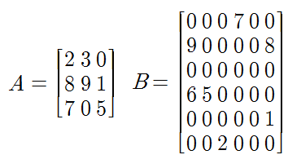
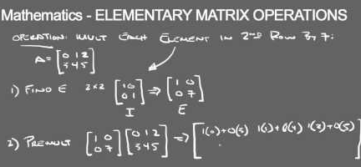
Matrix
The matrix is Used to solve many problems in natural science

Slide 67
Representation of matrices using multidimensional arrays
#include < stdio.h >
#define ROWS 3
#define COLS 3
int main( void )
{
int A[ROWS][COLS] = { { 2,3,0 },
{ 8,9,1 },
{ 7,0,5 } };
int B[ROWS][COLS] = { { 1,0,0 },
{ 1,0,0 },
{ 1,0,0 } };
int C[ROWS][COLS];

Slide 68
Representation of matrices using multidimensional arrays
int r, c;
// Add two matrices .
for (r = 0;r < ROWS; r++)
for (c = 0;c < COLS; c++ )
C[r][c] = A[r][c] + B[r][c];
// Print the matrix .
for (r = 0;r < ROWS; r++)
{
for (c = 0;c < COLS; c++ )
printf ( "%d " , C[r][c]);
printf ( "\n" );
}
return 0;
}
Using nested for loops, add each element of matrix A to each element of matrix B and assign it to matrix C.
3 3 0
9 9 1
8 0 5

Slide 69
Passing a 2-dimensional array to a function
#define _CRT_SECURE_NO_WARNINGS
#include < stdio.h >
#define YEARS 3
#define PRODUCTS 5
int sum( int scores [ YEARS ][ PRODUCTS ]);
int main( void )
{
int sales[ YEARS ][ PRODUCTS ] = { {1, 2, 3}, {4, 5, 6}, {7, 8, 9} };
int total_sale ;
total_sale = sum(sales);
printf ( " Total sales is %d .\n" , total_sale );
return 0;
}

Slide 70
Passing a 2-dimensional array to a function
int sum( int scores [ YEARS ][ PRODUCTS ])
{
int y, p;
int total = 0;
for (y = 0; y < YEARS ; y++)
for (p = 0; p < PRODUCTS ; p++)
total += scores [y][p];
return total;
}
Total sales are 45 .

Slide 71
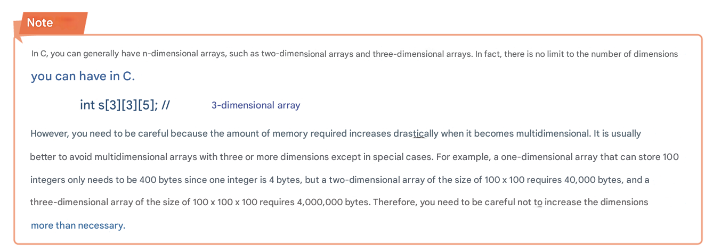
reference

Slide 72
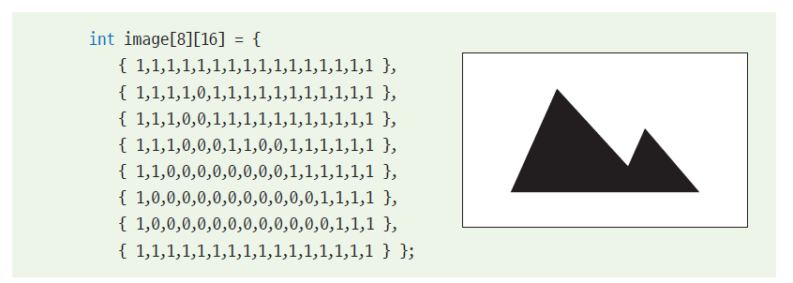
Lab: Image Processing
A digital image can be thought of as a 2-dimensional array of pixels .

Slide 73
Q & A

